Slide 1

UXBRIDGE –
SHAPING FOR THE FUTURE

Slide 2
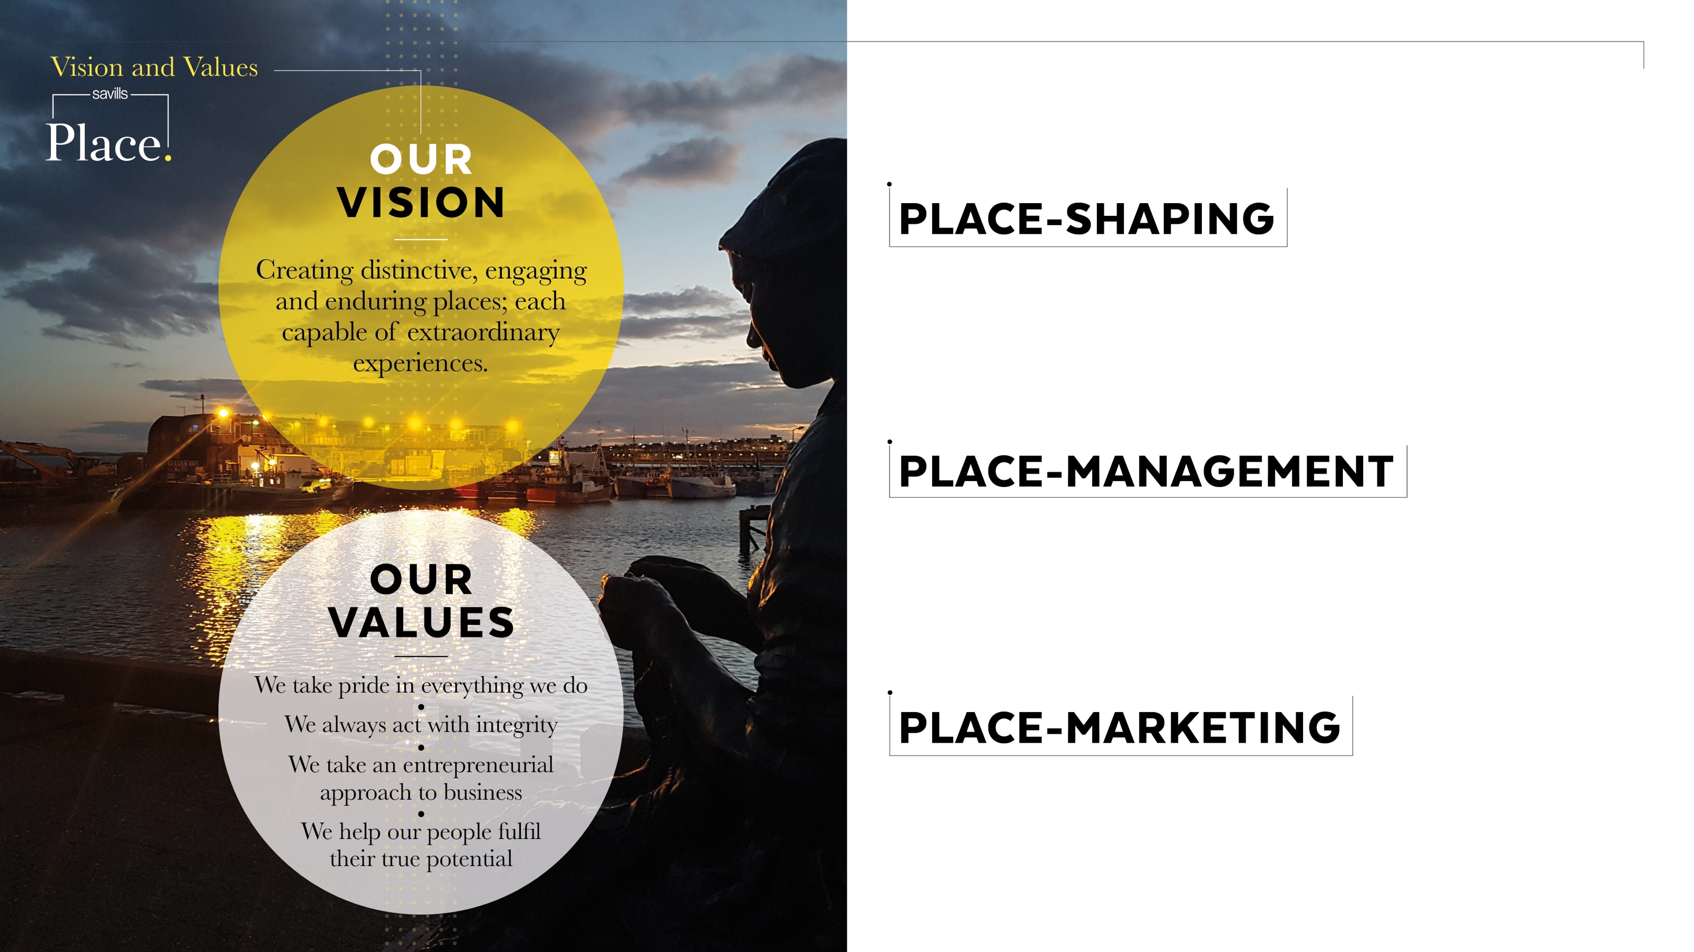

Notes:
A bit about us

Slide 3
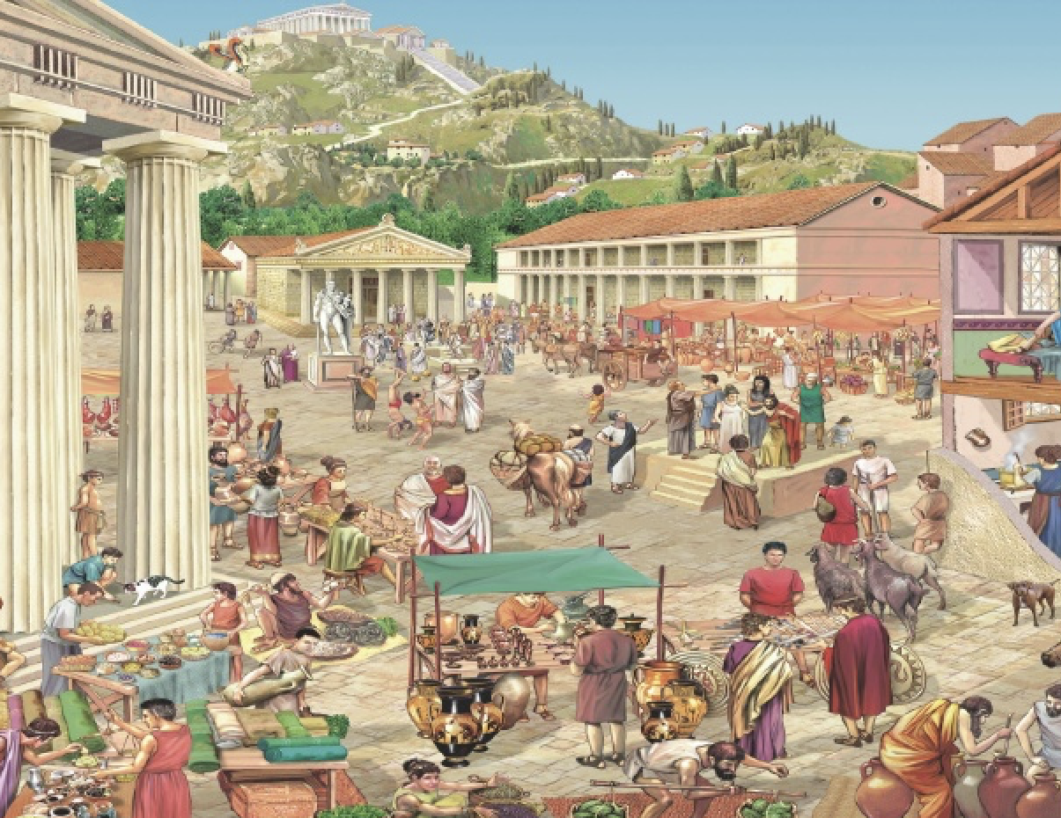
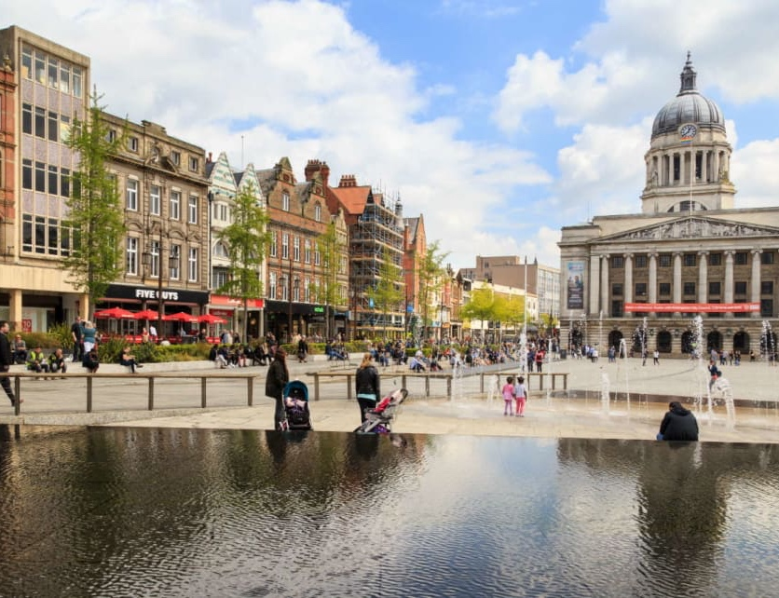
HISTORY LESSONS ON PLACE – “PLACES TO DO STUFF”
“Places where [people] see present day culture unfolding”
Jan Gehl, Danish architect
Agora Square
Modern Town Square
Savills Place
Notes:
History pf place

Slide 4

How Place Is Contested
Low Cost Travel
Car Parking
Internet
PLACE
Cost
Home Working
Movement
Globalisation
Investment
Competition

Slide 5

TODAY’S EMERGING CONSUMER
Employed
Debtor
Brand savvy
Technical
Entrepreneurial
Time poor
Individual
Mobile
Confident
Transient
Convenience
Traveller
Engaged
Sociable
Experiential
Immediate
Multi-
tasker
Socially-
conscious
Connected
Creative
Savills Place

Slide 6
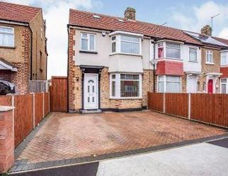
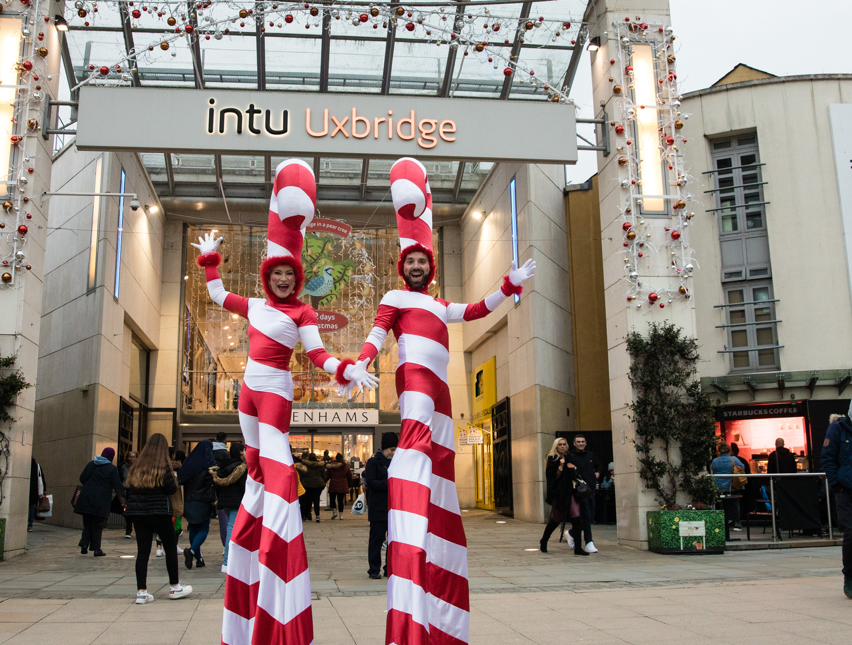
HOME LIFE
“Home feels good to leave, and even better to come back to”
Home
Place
Savills Place

Slide 7
















TODAY’S EMERGING CONSUMER
EXPENSIVE
Leisure travel
Attending live sports events
Video games and
related online services
Visitor attractions
Eating out
TV/Movie
streaming
subscription
Cost
Shopping
Culture &
entertainment
TV package
subscription
Night out
Gym membership
& other sports
Music
subscription
Takeaway food
Other discrete leisure
activities (bowling etc.)
Drinking out
coffee shops/cafes
CHEAP
Betting
& gaming
LESS FREQUENT
MORE FREQUENT
Frequency
Occasional FREQUENT
Savills Place

Slide 8





WHAT DEFINES PLACE-SHAPING
Design
Marketing
Connectivity
Enlivenment
DNA
Sustainability
Leadership
Composition
Perception
THE PHYSICAL CONSTRUCT
THE SOCIAL CONSTRUCT

Slide 9
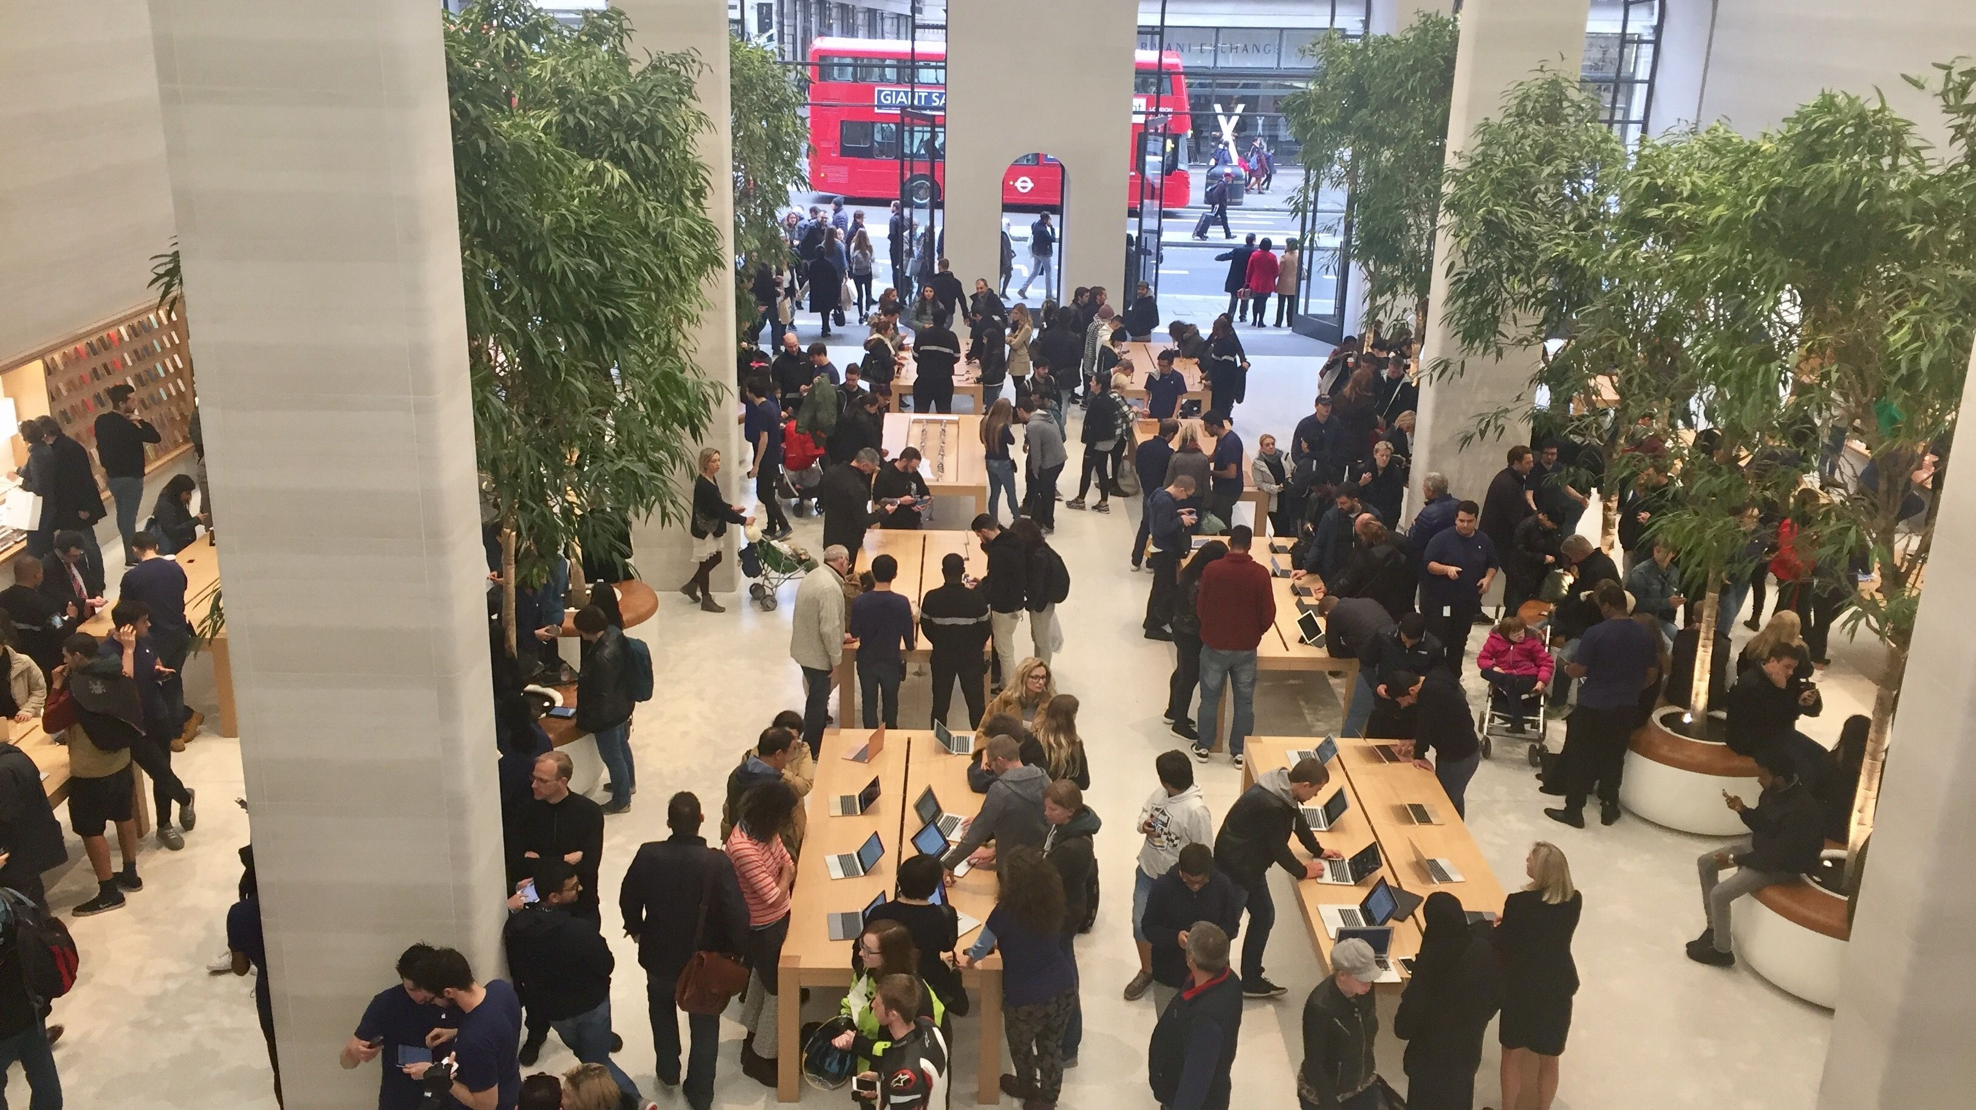

Savills Place

Slide 10
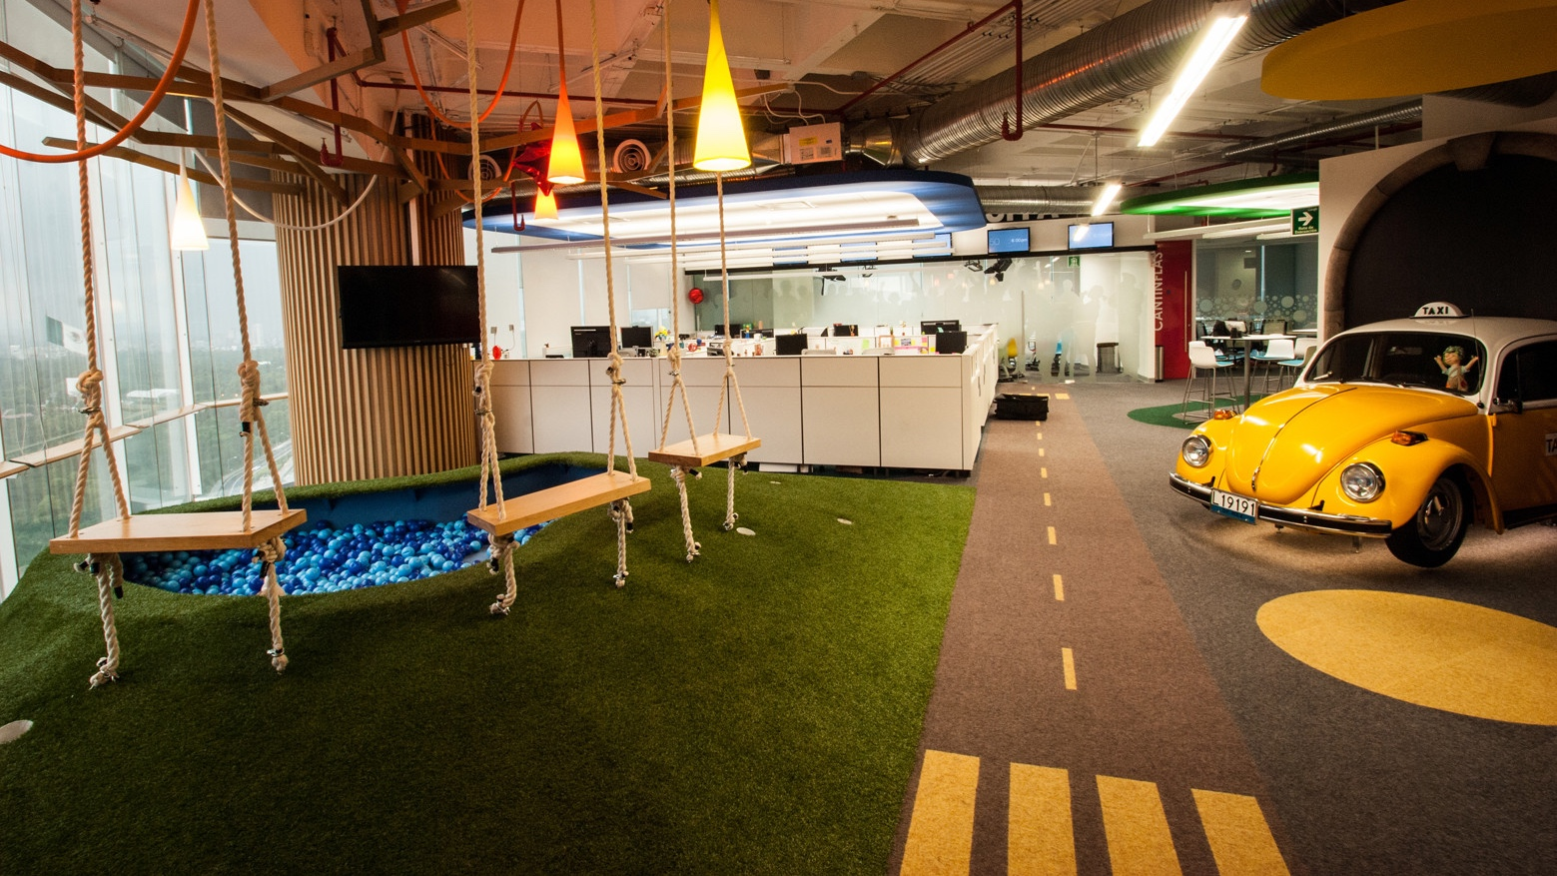

Savills Place-Shaping & Marketing
Savills Place

Slide 11


Savills Place

Slide 12
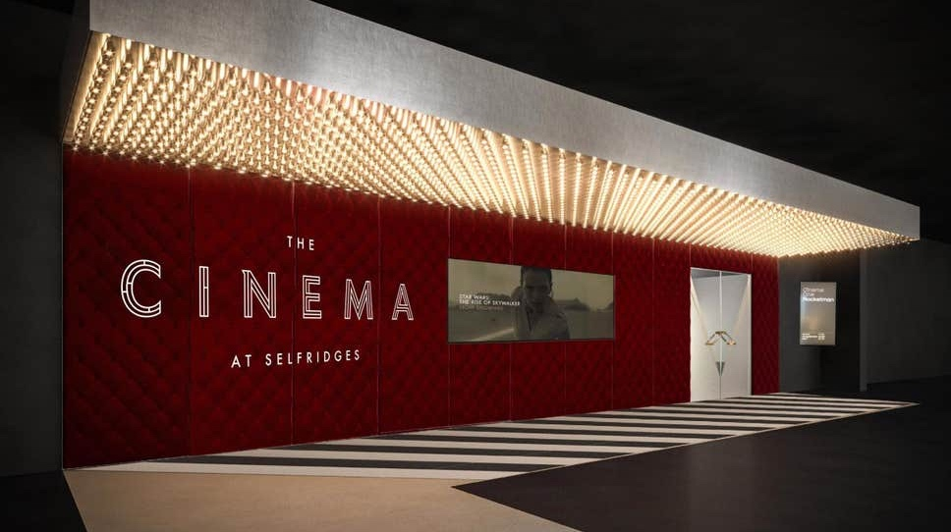

Savills Place

Slide 13


Savills Place

Slide 14

Background on BIDs
Originated in Canada
Legislation in England 2003 – 2004
First UK BID January 1st 2005
Rest of UK has followed, with some variations
Cross-Boundary BIDs (2013)
Property Owner BIDs and T-BIDs (2014)
UK Statistics
(British BIDs, National BIDs survey: 2019)
322 BIDs as at 31st March 2019
Total BID funding £229,173,716
Overall Success Ballot = 86%
Levy Rates mostly
1% - 2%
of Rateable Value (RV)
Total Hereditaments = 128,785
www.britishbids.info

Slide 15
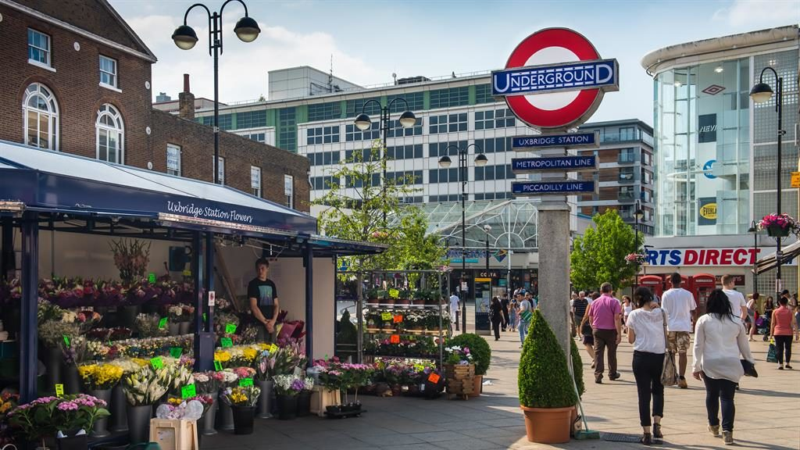

Savills Place

Slide 16


THANK YOU
place.savills.co.uk
britishbids.info

